Slide 1
How to Recognize Fake Email
Presented by:
SBS CyberSecurity

Slide 2
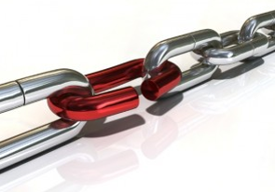
Why Do We Get Fake Emails?
97% of people cannot identify a sophisticated fake email
People are the weakest security link in most business processes
We can secure our networks, computers, systems, and internet access to make it more difficult to compromise information
People making decisions on emails that request action is a manual process that cannot always be controlled
It’s easier for hackers to use people to gather information and build schemes to get what they want

Slide 3
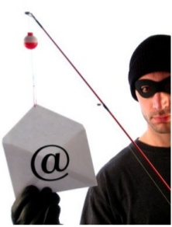
How to Recognize Fake Emails
Legitimate companies do not send email requesting sensitive information
Don’t trust the name in the from field of an email
If it looks suspicious do not open the email
Hover over links to see what address the link takes you
Open a new browser window and type the website address directly into the browser rather than clicking on the link
Most companies us secure web addresses identified by using https:// in the address bar instead of just http://

Slide 4
How to Recognize Fake Emails
Obvious grammar or spelling errors
Strange message structures
Generic greeting
Urgent language
Generic closing
When in doubt, click the “Reply All” button
This may reveal the true e-mail address
Don’t click on email attachments
Review the email signature
Lack of details on contacting the company

Slide 5
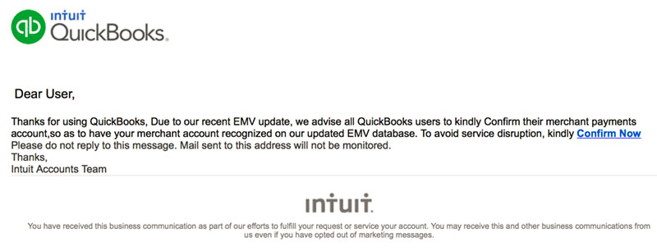
Alarmist Email Social Engineering
Do this or else
Criminals try to create a sense of urgency so you’ll respond without thinking

Slide 6
Alarmist Email Social Engineering
Do this or else
Criminals try to create a sense of urgency so you’ll respond without thinking

Slide 7
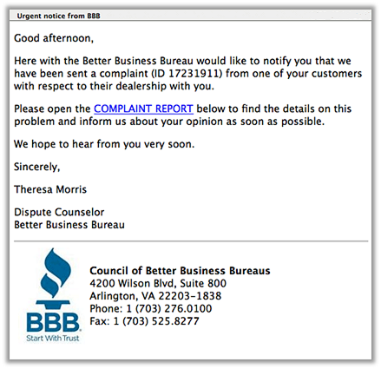
Grammar/Spelling Issues
Often times phishing messages have typos, grammatical errors, or extra characters

Slide 8
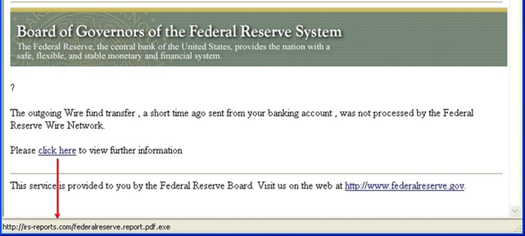
Examine Hyperlinks
Hover over links
Type into a browser to avoid subtle changes

Slide 9
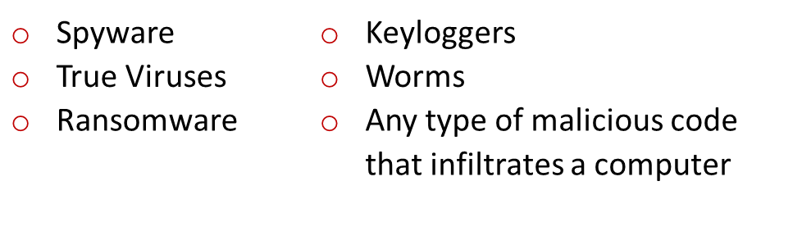
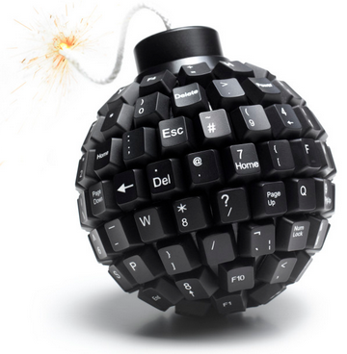
What is Malware?
Malware is an abbreviated term meaning “malicious software.” This is software that is specifically designed to gain access or damage a computer without the knowledge of the owner.
There are several types of malware;
Ransomware is a profitable criminal business, and its success lies in the way it develops the urgency using scare tactics.

Slide 10
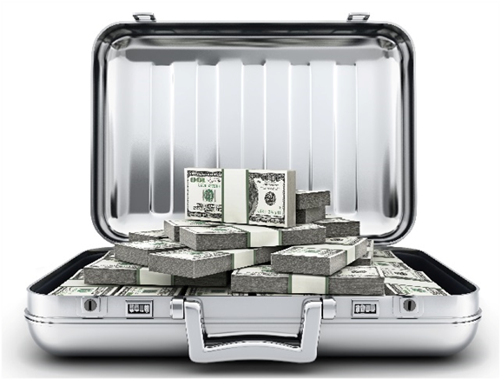
What is Ransomware?
Ransomware is a type of malicious software designed to block access to a computer system or mobile device until a sum of money is paid.
Ransomware is also referred to “Cyber Extortion”.
Two types of Ransomware;
Locker - ransomware denies access to the computer or device.
Crypto - ransomware prevents access to files or data.
Ransomware is often spread through phishing emails that contain malicious attachments or when a user unknowingly visits an infected website and then malware is downloaded and installed without the user’s knowledge.

Slide 11
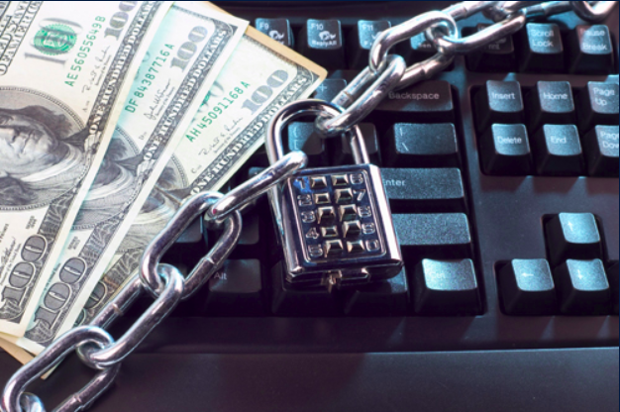
Recovery Options from Ransomware
Restore the system or files and data from the last backup.
Data lost since last backup
Pay the ransom to receive an encryption key to unlock the files and data.
Encourages more attacks

Slide 12
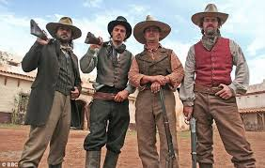
Phishing is Out of Control
Phishing email is like the Wild West with no one holding crime accountable and we have to defend ourselves.

Slide 13
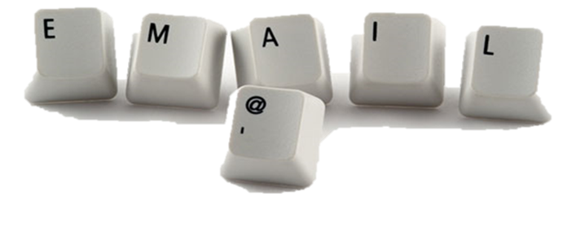
What to Do With These Emails
DO NOT CLICK ON UNKNOWN LINKS OR ATTACHMENTS
If you are not sure about the email, caution on the side of not opening the email
Contact the ISO or a member of the IT Department to let them know about the email and they will let you know what to do with it

Slide 14

Response to Clicking on a Fake Email
If you think you may have clicked on an email you shouldn’t have
Call the IT department to let them know before it is too late to fix
Do not click on other emails until the IT Department has cleared you to do so
Create an environment that encourages acknowledging the mistake so the IT Department can address the issue quickly

Slide 15


Fake Email Risk
IT only takes one compromise to get information
ONE PERSON–ONE MOMENT–ONE OPPORTUNITY
TODAY, ARE YOU GOING TO BE THAT ONE?

Slide 16



Presented by SBS CyberSecurity
(605) 923-8722
sales@sbscyber.com
www.sbscyber.com
Let’s Connect!
700 S Washington Ave Ste 200, Madison, SD 57042

